Slide 1




Group 3
Penetration Testing of
DVWA Web Application
01/27
Presented by:
Agbajeola Bisola – Project Lead
Adaobi Ogbonna – Environment Setup
Balogun Fawaz Aniekan – Penetration Tester
Jedidiah Abel – Security Analyst
Amina Bouchenafa – Presenter & Slide Designer

Slide 2


Objectives
Approach
DVWA setup process
Testing
Secure Coding Practices & SDLCMapping
Lessons learned
conclusion
02/27
Agenda

Slide 3



🎯 Objectives
03/27
To identify and exploit common web vulnerabilities using the DVWA platform
To simulate real-world penetration testing in a controlled lab environment
To understand and apply the OWASP Top 10 vulnerabilities
To document findings with clear evidence and remediation
To recommend secure coding practices

Slide 4
🔍 Approach
04/27
Set up a controlled testing environment using DVWA and Ngrok for external
access.
Simulated real-world attacks using manual testing and automated tools
(e.g., Burp Suite).
Targeted known vulnerabilities based on the OWASP Top 10 list.
Documented vulnerabilities, verified exploitation, and mapped them to secure
coding practices.

Slide 5

DVWA setup Process
05/27
In this section I will walk you through a step by step guide on how To setup Damn vulnerable web application on a windows host system Using docker and NGROK for external access

Slide 6

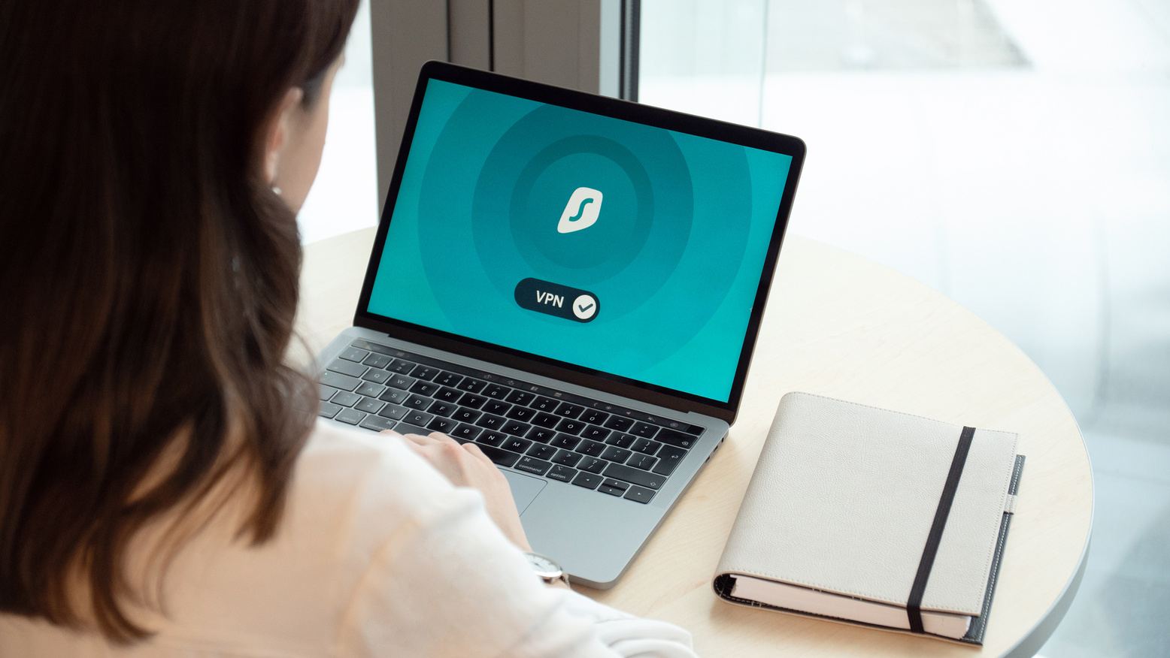
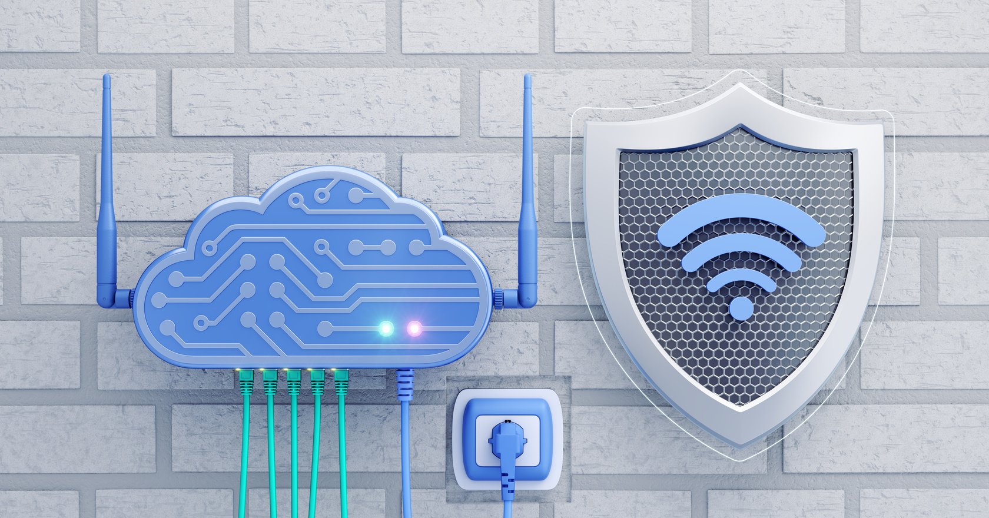
05/27
Step one we installed docker desktop from the official website docker.com with the functionally WSL2 enable.
Step two we pulled DVWA image using powershell command docker pull vulnerables/web-dvwa
Step three included running the DVWA container with this command docker run -d --name dvwa -p 80:80 vulnerables/web-dvwa”

Slide 7
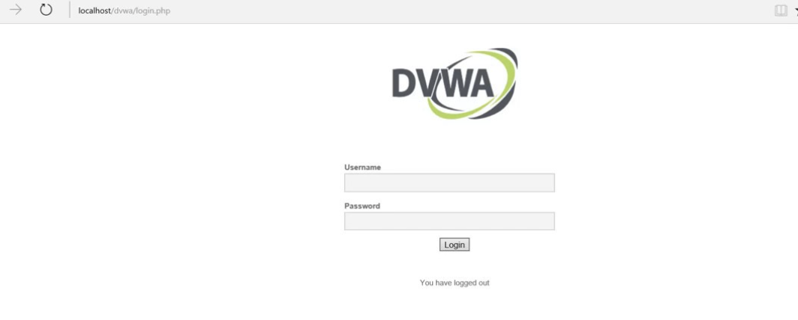
Step 4 : access DVWA loccaly
Opened a browser and navigated to http://localhost or http://localhost:8080.
Logged in using:
Username: admin
Password: password
Set DVWA Security Level to: Low
06/27

Slide 8

Ngrok setup
07/27
So ngrok was used to allow our penetration tester to access our DVWA that we hosted locally
So what is Ngrok ?
Ngrok is a tunneling tool that exposes local applications to the internet
it created a public URL to access DVWA running on our local machine
Allowed the penetration tester to acces DVWA remotely from another device

Slide 9
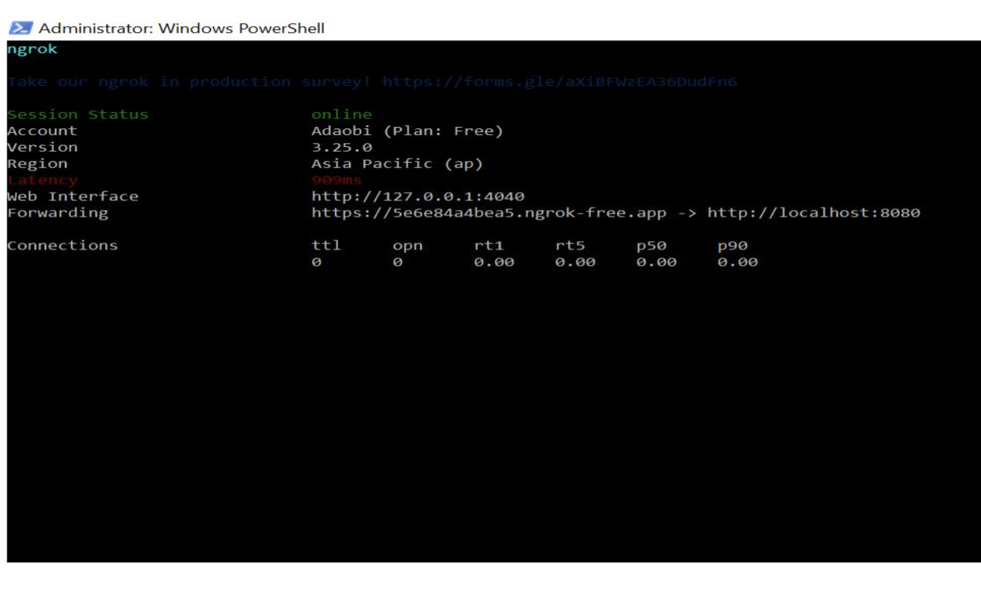
Install and configure ngrok
08/27
Step 1
Step 2
Download ngrok from it official website then we connected ngrok to our account
We started the tunnel and copied the link in out terminal and share it with our pentester

Slide 10


Testing the DVWA with OWASP
09/27
1. Testing Environment
Operating System: Kali Linux
Application: DVWA (Damn Vulnerable Web Application)
Tools Used: Burp Suite, Firefox
DVWA Security Level: Low.

Slide 11
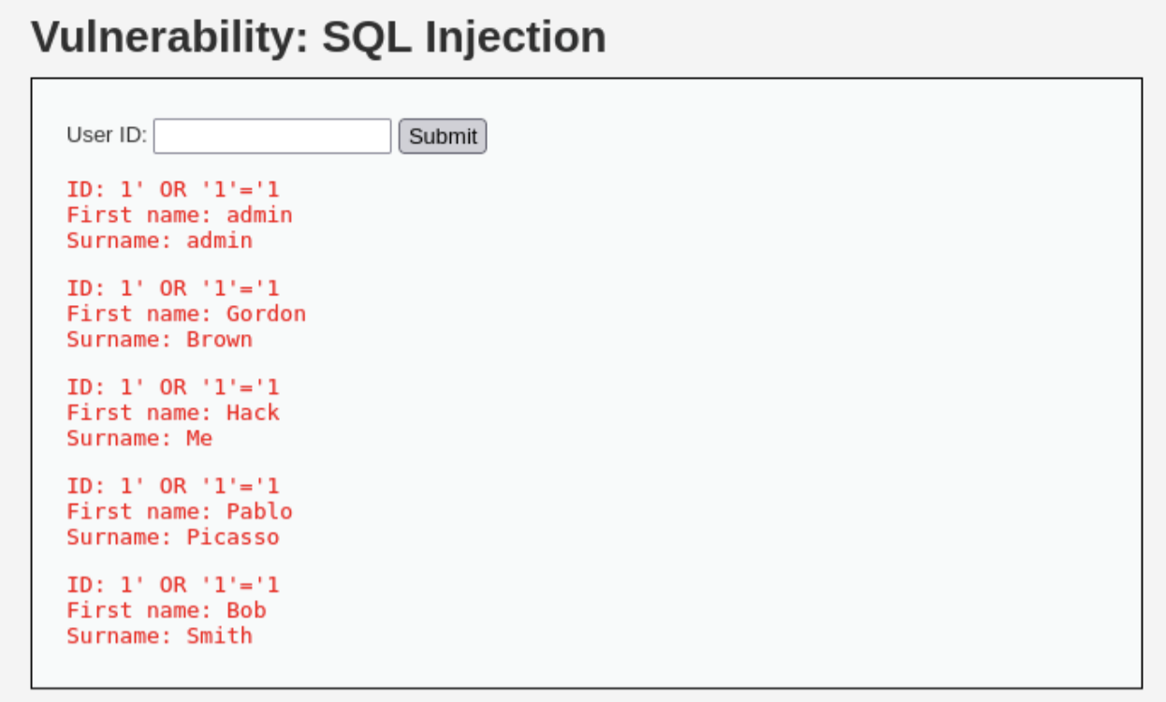
SQL Injection (OWASP A03:2021)
10/27
Using the payload `1&#39; OR &#39;1&#39;=&#39;1`, SQL Injection was successfully executed in the User ID field.
This exposed sensitive user information by manipulating the backend query.
Evidence of SQL Injection:

Slide 12
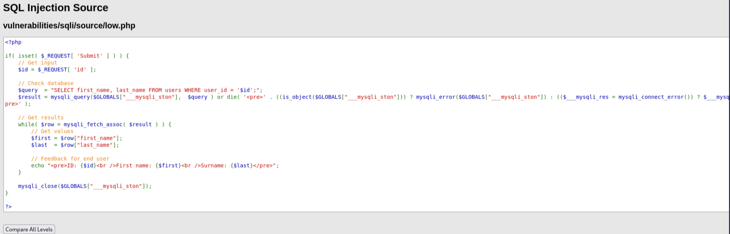
SQL Injection (OWASP A03:2021)
11/27
Source code showing vulnerability:

Slide 13
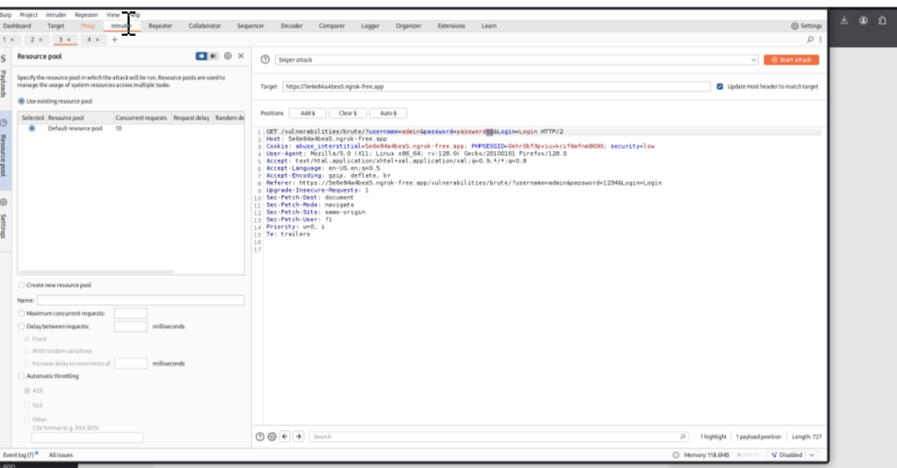
Brute Force (OWASP A07:2021)
12/27
A brute force attack was conducted using Burp Suite&#39;s Intruder module on the login form. By testing common passwords, access to the admin account was successfully achieved.
Burp Suite Intruder setup:

Slide 14
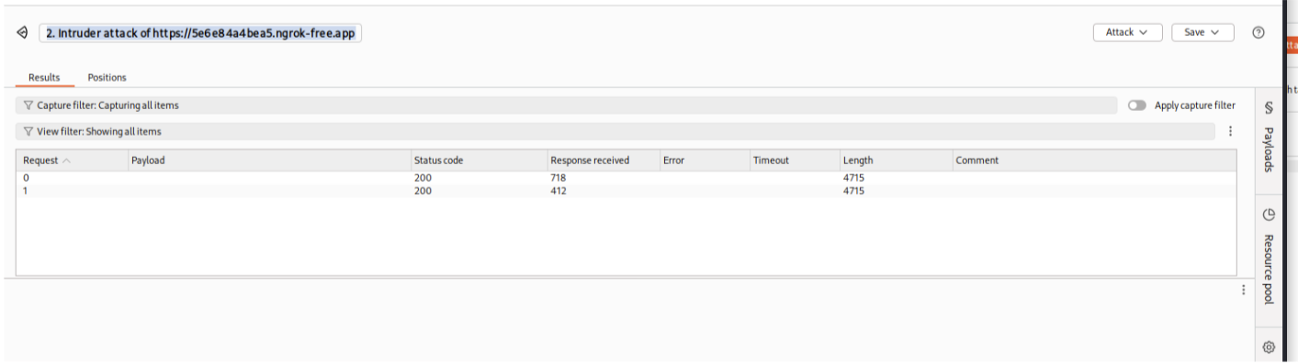
Intruder attack results:
13/27
Successful login confirmation

Slide 15
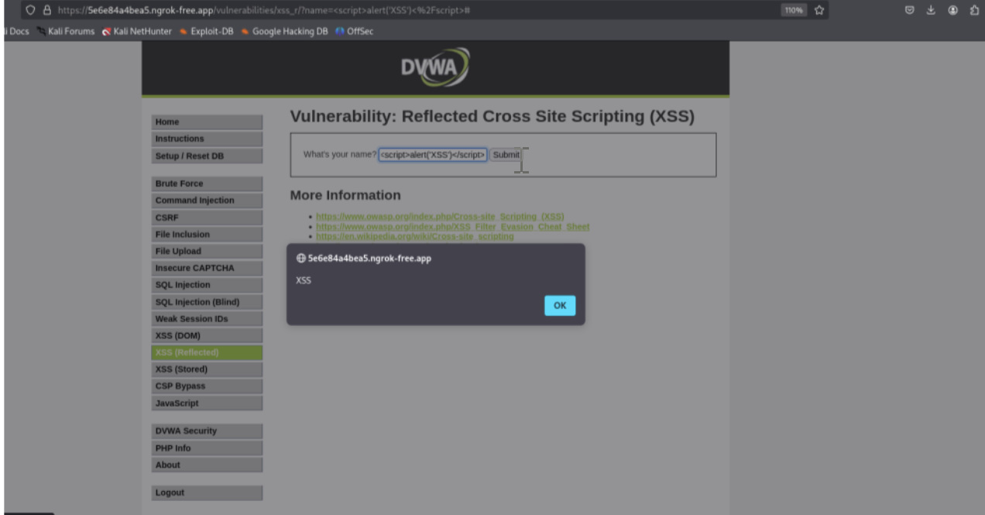
14/27
Cross-Site Scripting (XSS) – Reflected (OWASP A03:2021)
A simple `&lt;script&gt;alert(&#39;XSS&#39;)&lt;/script&gt;` payload triggered a reflected XSS vulnerability in the
input field, demonstrating that unescaped input was executed by the browser.
XSS payload executed:
Successful login confirmation

Slide 16
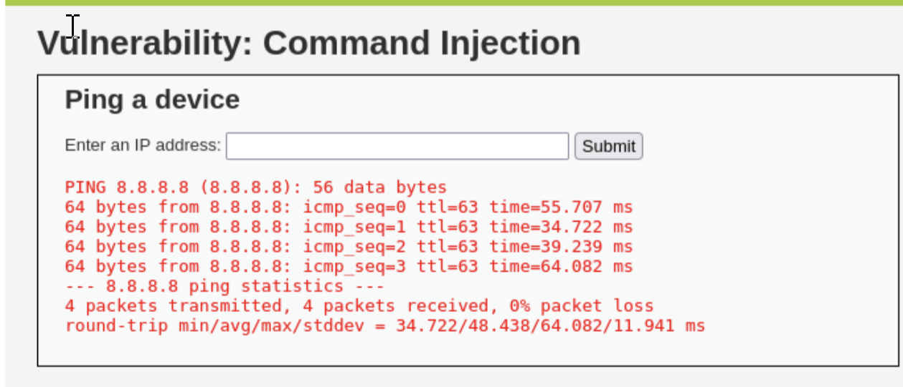
15/27
Command Injection (OWASP A01:2021)
The &#39;Ping a device&#39; feature was vulnerable to command injection due to direct input execution via
shell commands. The input was not sanitized, enabling potential arbitrary command execution.
Ping output shown (vulnerable):

Slide 17
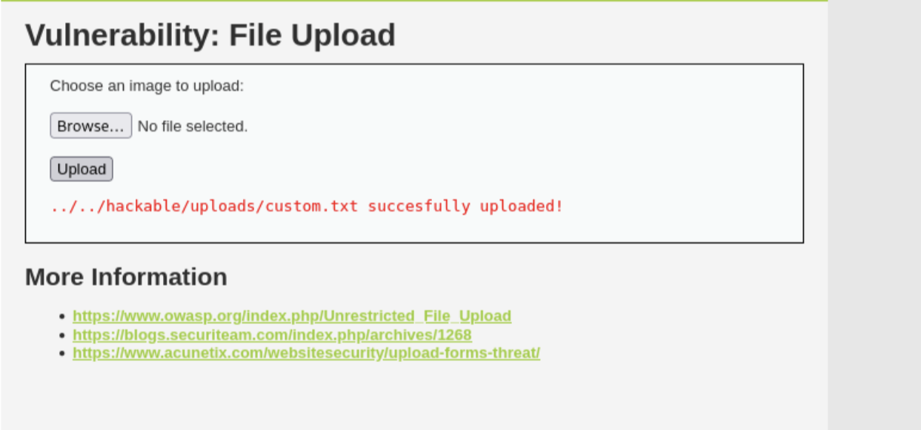
16/27
Unrestricted File Upload (OWASP A08:2021)
DVWA allowed upload of files such as `.txt` without validation. In a real system, this could
enable remote code execution by uploading malicious scripts.
Successful file upload message:

Slide 18
Secure Coding Practices
& SDLC Mapping
18/27
How to Mitigate Each Vulnerability Using OWASP & NIST Guidelines

Slide 19
SQL Injection – Mitigation & SDLC Integration
19/27
01
02
02
Secure coding practice
SDLC Mapping:
SDLC mapping
Use parameterized queries / prepared statements
Phase 1 (Requirements): Define allowed input patterns.
Phase 2 (Development): Implement parameterized queries
Phase 3 (Testing): Run SQLi tests & code reviews
Phase 4 (Operations): Restrict DB access, enable logging
Validate input using regex / allowlists
Restrict DB privileges (least privilege principle)

Slide 20
Brute Force – Mitigation & SDLC Integration
20/27
01
02
02
Secure coding practice
SDLC Mapping:
SDLC mapping
Lockouts,
CAPTCHA,
MFA,
rate-limiting
Requirements: Identify authentication flow and set password policies.
Design: Integrate CAPTCHA and MFA early in design.
Development: Use libraries for rate-limiting and login attempt tracking.
Testing: Simulate brute-force attempts using automated tools like Burp Suite.

Slide 21
🔹 XSS – Mitigation & SDLC Integration
21/27
01
02
02
Secure coding practice
SDLC Mapping:
SDLC mapping
Sanitize input,
encode output
CSP headers
Requirements → Define encoding
contexts Dev → Use secure templates
Testing → XSS scanning (e.g., ZAP)
Deployment → Set HTTP/CSP headers

Slide 22
🔹 Command Injection – Mitigation & SDLC Integration
22/27
01
02
02
Secure coding practice
SDLC Mapping:
SDLC mapping
input allowlists
avoid shell_exec
use APIs
Requirements → Document needed
commands Dev → Avoid shell functions
Testing → Inject test payloads
Deployment → Disable shell access for app users

Slide 23
🔹 🔹 File Upload – Mitigation & SDLC Integration
23/27
01
02
02
Secure coding practice
SDLC Mapping:
SDLC mapping
Validate MIME types
rename files
no execution rights
Requirements → Define file type & size rules
Dev → Use validation libraries
Testing → Upload harmful payloads
Deployment → Use noexec, virus scanning

Slide 24
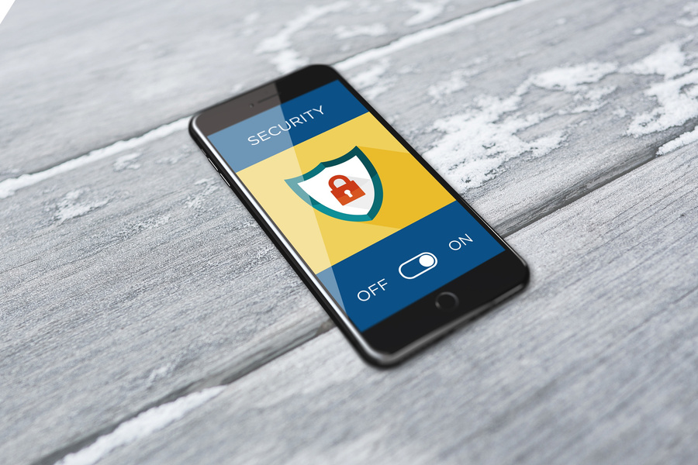



Recommendations & Best Practices
24/27
Implement Secure Coding Standards:
Continuous Security Training:
All developers should follow OWASP
secure coding practices. Regular code reviews and security linting should be
introduced.
Conduct recurring secure coding training and
security awareness programs for developers and QA staff.
Adopt a Secure SDLC Framework
Compliance and Policy Enforcement:
Integrate security at every phase of SDLC
Planning , design, development, testing,
deployment and maintenance :
Align with NIST SP 800-64 and OWASP
ASVS for process maturity and technical coverage.
Use Automated Security Tools
Integrate tools like:
SAST (Static Application Security Testing) for code analysis.
DAST (Dynamic Application Security Testing) for runtime testing.
Dependency Scanners (e.g., OWASP Dependency-Check) to monitor third-party libraries.

Slide 25
Lessons Learned
25/27
Setting up a testing environment is critical for safe vulnerability assessments.
Understanding OWASP Top 10 helps in identifying common security flaws.
Tools like Burp Suite and Ngrok are essential for practical penetration testing.
Secure coding practices are key to building safer web applications.
Mapping vulnerabilities to SDLC phases improves long-term security planning.

Slide 26

26/27
conclusion
This project demonstrated how common web vulnerabilities can be exploited using DVWA. It highlighted the importance of secure coding, regular testing, and following a secure development process. By applying best practices and security frameworks like OWASP and NIST, organizations can reduce risks and build safer web applications.

Slide 27
27/27
THANK
YOU!

